Slide 1



Lecture 4
Chapter 1. The Foundations
1.3 Introduction of Logic Circuits,Predicates and Quantifiers
4-<number>

Slide 2
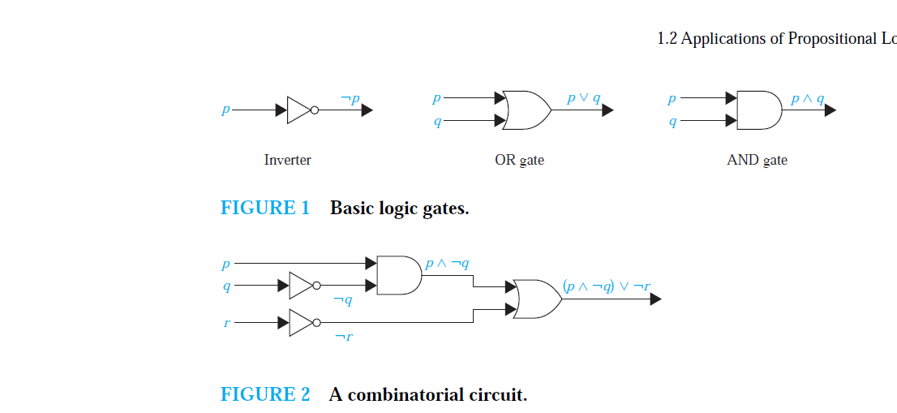
Logic Circuits
A logic circuit (or digital circuit) receives input signals p1, p2, . . . , pn, each a bit [either 0 (off) or 1 (on)], and produces output signals s1, s2, . . . , sn, each a bit.

Slide 3
EXAMPLE
Build a digital circuit that produces the output (p ∨￢r) ∧ (￢p ∨ (q ∨￢r)) when given input bits p, q, and r.
Solution:
To construct the desired circuit, we build separate circuits for p ∨￢r and
for ￢p ∨(q ∨￢r) and combine them using an AND gate.
To construct a circuit for p ∨￢r, we use an inverter to produce ￢r from the input r. Then, we use an OR gate to combine p and ￢r.
To build a circuit for ￢p ∨ (q ∨￢r), we first use an inverter to obtain ￢r.
Then we use an OR gate with inputs q and ￢r to obtain q ∨￢r.
Finally, we use another inverter and an OR gate to get ￢p ∨ (q ∨￢r) from the inputs p and q ∨￢r.
To complete the construction, we employ a final AND gate, with inputs p ∨￢r and ￢p ∨ q ∨￢r).

Slide 4
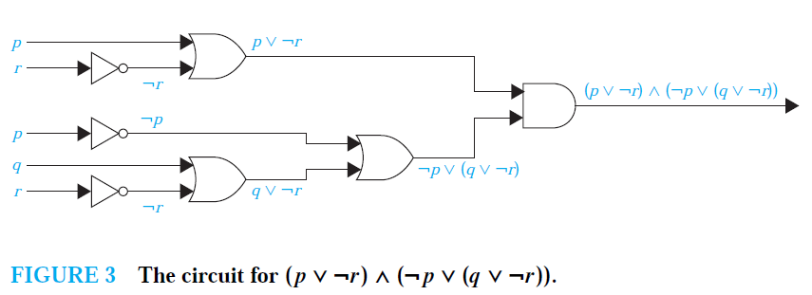
SOLUTION

Slide 5
Propositional Satisfiability
A compound proposition is satisfiable if there is an assignment of truth values to its variables that makes it true.
compound proposition is unsatisfiable if and only if its negation is true for all assignments of truth values to the variables, that is, if and only if its negation is a tautology.

Slide 6
EXAMPLE
Determine whether each of the compound propositions
(p ∨￢q) ∧ (q ∨￢r) ∧(r ∨￢p),
(p ∨ q ∨ r) ∧ (￢p ∨￢q ∨￢r), and
(p ∨￢q) ∧ (q ∨￢r) ∧ (r ∨￢p) ∧(p ∨ q ∨ r) ∧ (￢p ∨￢q ∨￢r)
is satisfiable.
SOL:
(p ∨￢q) ∧ (q ∨￢r) ∧ (r ∨￢p) is true when the three variable p, q, and r have the same truth value.
Hence, it is satisfiable as there is at least one assignment of truth values for p, q, and r that makes it true.
(p ∨ q ∨ r) ∧ (￢p ∨￢q ∨￢r) is true when at least one of p, q, and r is true and at least one is false.
Hence, (p ∨ q ∨ r) ∧ (￢p ∨￢q ∨￢r) is satisfiable,
as there is at least one assignment of truth values for p, q, and r that makes it true.

Slide 7
EXAMPLE con...
(p ∨￢q) ∧ (q ∨￢r) ∧ (r ∨￢p) ∧ (p ∨ q ∨ r) ∧ (￢p ∨￢q ∨￢r)
to be true, (p ∨￢q) ∧ (q ∨￢r) ∧ (r ∨￢p) and (p ∨ q ∨ r) ∧ (￢p ∨￢q ∨￢r) must both be true.
For the first to be true, the three variables must have the same truth values,
for the second to be true, at least one of three variables must be true and at least one must be false.
these conditions are contradictory. From these observations we conclude
that no assignment of truth values to p, q, and r makes
(p ∨￢q) ∧ (q ∨￢r) ∧ (r ∨￢p) ∧(p ∨ q ∨ r) ∧ (￢p ∨￢q ∨￢r) true. Hence, it is unsatisfiable.

Slide 8
Predicates
Propositional logic, cannot adequately express the meaning of all statements in mathematics and in natural language.
For example, suppose that we know that
“Every computer connected to the university network is functioning properly.”
Statements involving variables, such as
“x > 3,” “x = y + 3,” “x + y = z,”
and
“computer x is under attack by an intruder,”
and
“computer x is functioning properly,”
These statements are neither true nor false when the values of the variables are not specified.
propositions can be produced from such statements.

Slide 9
Predicates
The statement “x is greater than 3” has two parts.
The first part, the variable x, is the subject of the statement.
The second part—the predicate, “is greater than 3”—refers to a property that the subject of the statement can have.
We can denote the statement “x is greater than 3” by P(x),
where P denotes the predicate “is greater than 3” and x is the variable. The statement P(x) is also said to be the value of the propositional function P at x.
Once a value has been assigned to the variable x, the statement P(x) becomes a proposition and has a truth value.
EXAMPLE
Let P(x) denote the statement “x > 3.” What are the truth values of P(4) and P(2)?
EXAMPLE
Let A(x) denote the statement “Computer x is under attack by an intruder.” Suppose that of the computers on campus, only CS2 and MATH1 are currently under attack by intruders. What are truth values of A(CS1), A(CS2), and A(MATH1)?

Slide 10


Previously…
In predicate logic, a predicate is modeled as a proposional function P(·) from subjects to propositions.
  P(x): “x is a prime number” (x: any subject)
  P(3): “3 is a prime number.” (proposition!)
Propositional functions of any number of arguments, each of which may take any grammatical role that a noun can take
  P(x,y,z): “x gave y the grade z”
  P(Mike,Mary,A): “Mike gave Mary the grade A.”
4-<number>

Slide 11
Quantifiers
Quantification expresses the extent to which a predicate is true over a range of elements. In English, the words all, some, many, none, and few are used in quantifications.
universal quantification- predicate is true for every element under consideration.
existential quantification- there is one or more element under consideration for which the predicate is true.

Slide 12

Universe of Discourse (U.D.)
The power of distinguishing subjects from predicates is that it lets you state things about many objects at once.
e.g., let P(x) = “x + 1 > x”. We can then say, “For any number x, P(x) is true” instead of (0 + 1 > 0) ∧ (1 + 1 > 1) ∧ (2 + 1 > 2) ∧ ...
The collection of values that a variable x can take is called x’s universe of discourse or the domain of discourse.
4-<number>

Slide 13

Quantifier Expressions
Quantifiers provide a notation that allows us to quantify (count) how many objects in the universe of discourse satisfy the given predicate.
“∀” is the FOR ΑLL or universal quantifier.
∀x P(x) means for all x in the domain, P(x).
“∃” is the ΕXISTS or existential quantifier.
∃x P(x) means there exists an x in the domain (that is, 1 or more) such that P(x).
4-<number>

Slide 14

The Universal Quantifier ∀
∀x P(x): For all x in the domain, P(x).
∀x P(x) is
  true if P(x) is true for every x in D (D: domain of discourse)
  false if P(x) is false for at least one x in D
For every real number x, x² ≥ 0
TRUE
For every real number x, x² – 1 > 0 FALSE
A counterexample to the statement ∀x P(x) is a value x in the domain D that makes P(x) false
What is the truth value of ∀x P(x) when the domain is empty? TRUE
4-<number>

Slide 15

The Universal Quantifier ∀
If all the elements in the domain can be listed as x₁, x₂,…, x_{n} then, ∀x P(x) is the same as the conjunction:
P(x₁) ∧ P(x₂) ∧ ··· ∧ P(x_{n})
Example: Let the domain of x be parking spaces at UH. Let P(x) be the statement “x is full.” Then the universal quantification of P(x), ∀x P(x), is the proposition:
  “All parking spaces at UH are full.”
  or “Every parking space at UH is full.”
  or “For each parking space at UH, that space is full.”
4-<number>

Slide 16
The Existential Quantifier ∃
∃x P(x): There exists an x in the domain (that is, 1 or more) such that P(x).
∃x P(x) is
  true if P(x) is true for at least one x in the domain
  false if P(x) is false for every x in the domain
What is the truth value of ∃x P(x) when the domain is empty? FALSE
If all the elements in the domain can be listed as x₁, x₂,…, x_{n} then, ∃x P(x) is the same as the disjunction:
P(x₁) ∨ P(x₂) ∨ ··· ∨ P(x_{n})
4-<number>

Slide 17

The Existential Quantifier ∃
Example:
Let the domain of x be parking spaces at UH. Let P(x) be the statement “x is full.”
Then the existential quantification of P(x),
∃x P(x), is the proposition:
  “Some parking spaces at UH are full.”
  or “There is a parking space at UH that is full.”
  or “At least one parking space at UH is full.”
4-<number>

Slide 18
Free and Bound Variables
An expression like P(x) is said to have a free variable x (meaning, x is undefined).
A quantifier (either ∀ or ∃) operates on an expression having one or more free variables, and binds one or more of those variables, to produce an expression having one or more bound variables.
4-<number>

Slide 19



Example of Binding
P(x,y) has 2 free variables, x and y.
∀x P(x,y) has 1 free variable , and one
bound variable . [Which is which?]
“P(x), where x = 3” is another way to bind x.
An expression with zero free variables is a bona-fide (actual) proposition.
An expression with one or more free variables is not a proposition:
e.g. ∀x P(x,y) = Q(y)
4-<number>

Slide 20
Scope
The statement ∃x(x + y = 1), the variable x is bound by the existential quantification ∃x, but the variable y is free because it is not bound by a quantifier and no value is assigned to this
variable. This illustrates that in the statement ∃x(x + y = 1), x is bound, but y is free.
Scope
∃x(P(x) ∧ Q(x)) ∨ ∀xR(x)- all variables are bound
The scope of the first quantifier, ∃x, is the expression P(x) ∧ Q(x) because ∃x is applied only to P(x) ∧ Q(x), and
not to the rest of the statement. Similarly, the scope of the second quantifier, ∀x, is the expression R(x).

Slide 21

Quantifiers with Restricted Domains
  An abbreviated notation is often used to restrict the domain of a quantifier, a condition a variable must satisfy is included after the quantifier.
  ∀x>0 P(x) is shorthand for
“For all x that are greater than zero, P(x).”
= ∀x (x > 0 → P(x))
  ∃x>0 P(x) is shorthand for
“There is an x greater than zero such that
P(x).”
= ∃x (x > 0 ∧ P(x))
4-<number>

Slide 22
Example
What do the statements ∀x < 0 (x2 > 0),∀y = 0 (y3 = 0),and∃z > 0(z2 = 2) mean, where the domain in each case consists of the real numbers?
Solution: The statement ∀x < 0 (x2 > 0) states that for every real number x withx < 0, x2 > 0.
That is, it states “The square of a negative real number is positive.” This statement is the same as ∀x(x < 0 → x2 > 0).
The statement ∀y = 0 (y3 = 0) states that for every real number y with y = 0, we have y3 = 0. That is, it states “The cube of every nonzero real number is nonzero.”
Note that this statement is equivalent to ∀y(y = 0 → y3 = 0).
Finally, the statement ∃z > 0 (z2 = 2) states that there exists a real number z with z > 0 such that z2 = 2. That is, it states “There is a positive square root of 2.” This statement is equivalent to ∃z(z > 0 ∧ z2 = 2).

Slide 23

Translating from English
Express the statement “Every student in this class has studied calculus” using predicates and quantifiers.
  Let C(x) be the statement: “x has studied calculus.”
  If domain for x consists of the students in this class, then
  it can be translated as ∀x C(x)
or
  If domain for x consists of all people
  Let S(x) be the predicate: “x is in this class”
  Translation: ∀x (S(x) → C(x))
4-<number>

Slide 24
Translating from English
Express the statement “Some students in this class has visited Mexico” using predicates and quantifiers.
  Let M(x) be the statement: “x has visited Mexico”
  If domain for x consists of the students in this class, then
  it can be translated as ∃x M(x) or
  If domain for x consists of all people
  Let S(x) be the statement: “x is in this class”
  Then, the translation is ∃x (S(x) ∧ M(x))
4-<number>

Slide 25
Translating from English
Express the statement “Every student in this class has visited either Canada or Mexico” using predicates and quantifiers.
  Let C(x) be the statement: “x has visited Canada” and M(x) be the statement: “x has visited Mexico”
  If domain for x consists of the students in this class, then
  it can be translated as ∀x (C(x) ∨ M(x))
4-<number>

Slide 26
Example
Q.Use predicates and quantifiers to express the system specifications “Every mail message larger than one megabyte will be compressed” and “If a user is active, at least one network link will be available.”
Solution: Let S(m, y) be “Mail message m is larger than y megabytes,” where the variable x has the domain of all mail messages and the variable y is a positive real number, and let C(m) denote “Mail message m will be compressed.” Then the specification “Every mail message larger than one megabyte will be compressed” can be represented as ∀m(S(m, 1) → C(m)).
Let A(u) represent “User u is active,” where the variable u has the domain of all users,
let S(n, x) denote “Network link n is in state x,” where n has the domain of all network links and x has the domain of all possible states for a network link.
Then the specification
“If a user is active, at least one network link will be available” can be represented by ∃uA(u) → ∃nS(n, available).

Slide 27
Example
Q.Consider these statements. The first two are called premises and the third is called the conclusion.
The entire set is called an argument.
“All lions are fierce.”
“Some lions do not drink coffee.”
“Some fierce creatures do not drink coffee.”
Solution: We can express these statements as:
∀x(P(x) → Q(x)).
∃x(P(x) ∧ ￢R(x)).
∃x(Q(x) ∧ ￢R(x)).
Notice that the second statement cannot be written as ∃x(P(x)→￢R(x)). The reason is that P(x)→￢R(x) is true whenever x is not a lion, so that ∃x(P(x)→￢R(x)) is true as long as there is at least one creature that is not a lion, even if every lion drinks coffee. Similarly, the third statement cannot be written as ∃x(Q(x)→￢R(x)).

Slide 28
Example
Consider these statements, of which the first three are premises and the fourth is a valid conclusion.
“All hummingbirds are richly colored.”
“No large birds live on honey.”
“Birds that do not live on honey are dull in color.”
“Hummingbirds are small.”
Let P(x), Q(x), R(x), and S(x) be the statements “x is a hummingbird,” “x is large,” “x lives on honey,” and “x is richly colored,” respectively. Assuming that the domain consists of all birds, express the statements in the argument using quantifiers and P(x), Q(x), R(x), and S(x).
Solution:We can express the statements in the argument as
∀x(P(x) → S(x)).
￢∃x(Q(x) ∧ R(x)).
∀x(￢R(x)→￢S(x)).
∀x(P(x)→￢Q(x)).

Slide 29
Negations of Quantifiers
∀x P(x): “Every student in the class has taken a course in calculus” (P(x): “x has taken a course in calculus”)
  “Not every student in the class … calculus”
¬∀x P(x) ≡ ∃x ¬P(x)
Consider ∃x P(x): “There is a student in the class who has taken a course in calculus”
  “There is no student in the class who has taken a course in calculus”
¬∃x P(x) ≡ ∀x ¬P(x)
4-<number>

Slide 30


Negations of Quantifiers
Definitions of quantifiers: If the domain = {a, b, c,…}
  ∀x P(x) ≡ P(a) ∧ P(b) ∧ P(c) ∧ ∙∙∙
  ∃x P(x) ≡ P(a) ∨ P(b) ∨ P(c) ∨ ∙∙∙
From those, we can prove the laws:
  ¬∀x P(x) ≡ ¬(P(a) ∧ P(b) ∧ P(c) ∧ ∙∙∙ )
≡ ¬P(a) ∨ ¬P(b) ∨ ¬P(c) ∨ ∙∙∙
≡ ∃x ¬P(x)
  ¬∃x P(x) ≡ ¬(P(a) ∨ P(b) ∨ P(c) ∨ ∙∙∙ )
≡ ¬P(a) ∧ ¬P(b) ∧ ¬P(c) ∧ ∙∙∙
≡ ∀x ¬P(x)
Which propositional equivalence law was used to prove this?
4-<number>

Slide 31

Negations of Quantifiers
Theorem:
Generalized De Morgan's laws for logic 1. ¬∀x P(x) ≡ ∃x ¬P(x)
2. ¬∀x P(x) ≡ ∃x ¬P(x)
4-<number>

Slide 32
Negations: Examples
What are the negations of the statements
∀x (x² > x) and ∃x (x² = 2)?
¬∀x (x² > x) ≡ ∃x ¬(x² > x) ≡ ∃x (x² ≤ x)
¬∃x (x² = 2) ≡ ∀x ¬(x² = 2) ≡ ∀x (x² ≠ 2)
■
Show that ¬∀x(P(x) → Q(x)) and
∃x(P(x) ∧ ¬Q(x)) are logically equivalent.
  ¬∀x(P(x) → Q(x)) ≡ ∃x ¬(P(x) → Q(x))
≡ ∃x ¬(¬P(x) ∨ Q(x))
≡ ∃x (P(x) ∧ ¬Q(x))
4-<number>

Slide 33
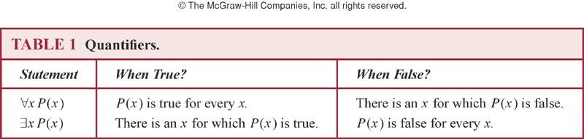
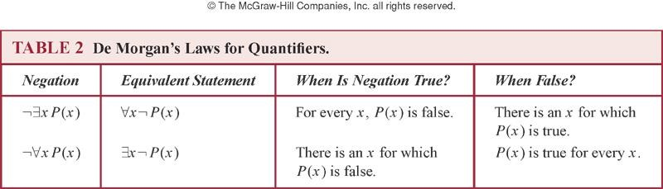
Summary

Slide 34
Logic Programming
A programming language is designed to reason using the rules of predicate logic. Prolog (from Programming in Logic)
Prolog programs include a set of declarations consisting of two types of statements.
Prolog facts and Prolog rules. Prolog facts define predicates by specifying the elements that satisfy these predicates.
Prolog rules are used to define new predicates using those already defined by Prolog facts.

Slide 35
Example
Consider a Prolog program given facts telling it the instructor of each class and in which classes students are enrolled. The program uses these facts to answer queries concerning the professors who teach particular students. Such a program could use the predicates instructor(p, c) and enrolled(s, c) to represent that professor p is the instructor of course c and that student s is enrolled in course c, respectively. For example, the Prolog facts in such a program might include:
instructor(chan,math273)
instructor(patel,ee222)
instructor(grossman,cs301)
enrolled(kevin,math273)
enrolled(juana,ee222)
enrolled(juana,cs301)
enrolled(kiko,math273)
enrolled(kiko,cs301)

Slide 36
Example
Lowercase letters have been used for entries because Prolog considers names beginning with an uppercase letter to be variables.
A new predicate teaches(p, s), representing that professor p teaches student s, can be defined using the Prolog rule
teaches(P,S) :- instructor(P,C), enrolled(S,C)
teaches(p, s) is true if there exists a class c such that professor p is the instructor of class c and student s is enrolled in class c.
(Note that a comma is used to represent a conjunction of predicates in Prolog. Similarly, a semicolon is used to represent a disjunction
of predicates.)
Prolog answers queries using the facts and rules it is given. For example, using the facts and rules listed, the query ?enrolled(kevin,math273)
produces the response yes

Slide 37
Example
?enrolled(X,math273)
kevin
Kiko
To find all the professors who are instructors in classes being taken by Juana, we use the query
?teaches(X,juana)
This query returns
patel
grossman

